Slide 1


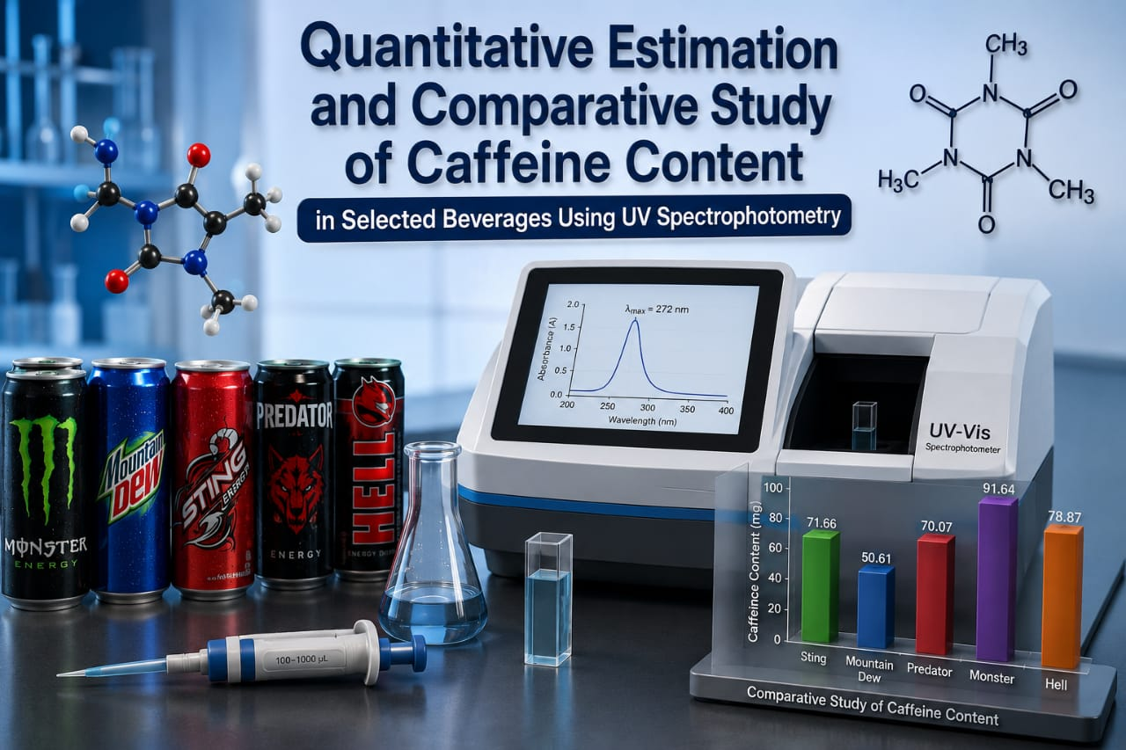
SINHGAD TECHNICAL EDUCATION SOCIETY’S
SINHGAD INSTITUTE OF PHARMACY
NARHE, PUNE- 411041
Affiliated To – Savitribai Phule Pune University
PRESENTATION TOPIC NAME
Quantitative Estimation and Comparative Study of Caffeine Content in Selected Beverages Using UV Spectrophotometry
Project Submitted By
Mr. Sumit Kamble
Mr. Yuvraj Jagtap
Mr. Sushrut Randive
Ms. Sayali Renge
Mr. Samarth Sangale
Research Guide
Dr. Shraddha Tathe
Department
Pharmaceutical Chemistry
Date
25/05/2026
Academic Year
2025 - 2026

Slide 2
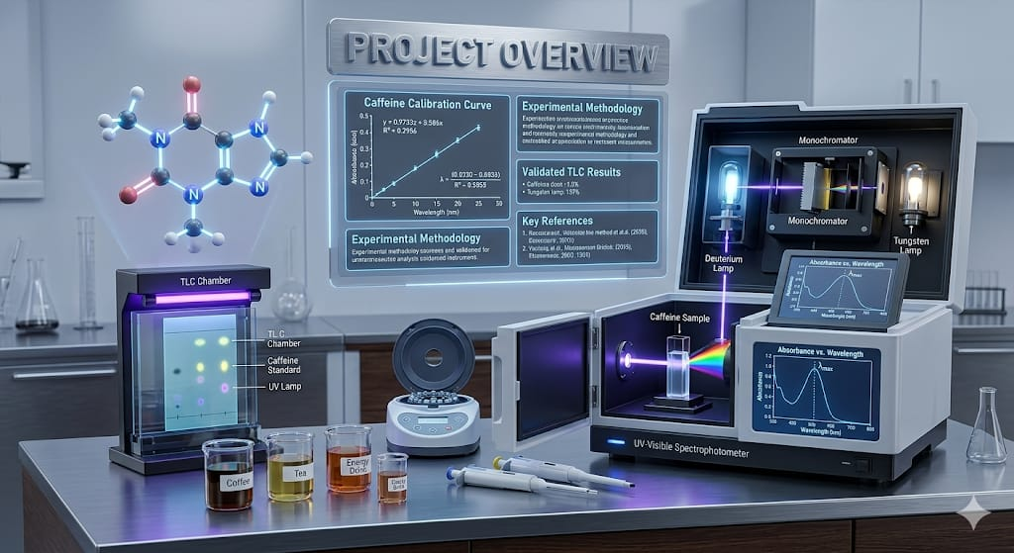
CONTENTS
Introduction
Aim & Objectives
Principle Of UV Spectrophotometry
Parts Of UV Spectrometry
Applications Of UV Spectrophotometry
Drug Profile Of Caffeine
Materials & Instruments
Experimental Methodology
Result & Discussion
Conclusion Of Project
References & Acknowledgement

Slide 3
INTRODUCTION
Slide no- 1

Slide 4
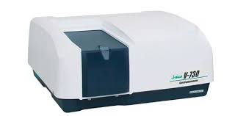
INTRODUCTION
UV Spectrophotometry is an important analytical technique used for identification and quantitative estimation of chemical compounds based on absorption of ultraviolet light.
Caffeine is a naturally occurring alkaloid widely present in energy drinks, soft drinks, tea, and coffee.
Excessive caffeine intake may affect human health by causing insomnia, anxiety, and increased heart rate.
In the present study, UV Spectrophotometry was used for quantitative estimation and comparative analysis of caffeine content in selected commercially available beverages.
UV-Spectrophotometer
Slide no - 2

Slide 5
AIM & OBJECTIVES
Slide no -3

Slide 6
AIM & OBJECTIVES
Aim Of Project
To quantitatively estimate and compare the caffeine content present in selected commercially available beverages using UV Spectrophotometry.
Objectives Of Project
To determine the λmax of caffeine.
To prepare calibration curve of caffeine using UV Spectrophotometry.
To estimate caffeine content in selected beverages.
To compare experimental values with label claims.
To evaluate the suitability of UV Spectrophotometric method for caffeine analysis.
Slide no - 4

Slide 7
PRINCIPLE OF UV SPECTROPHOTOMETRY
Slide no - 5

Slide 8
PRINCIPLE OF UV SPECTROPHOTOMETRY
UV Spectrophotometry is based on the absorption of ultraviolet radiation by molecules containing chromophores.
When UV light passes through a sample solution, caffeine absorbs radiation at a specific wavelength, resulting in electronic transitions.
The concentration of caffeine is determined using Beer–Lambert’s Law.
Where:
A = Absorbance
a = Molar absorptivity
b = Path length of cuvette
c = Concentration of solution
The absorbance is directly proportional to concentration of caffeine.
A = abc
Slide no - 6

Slide 9
PARTS OF UV SPECTROPHOTOMETRY
Slide no - 7

Slide 10
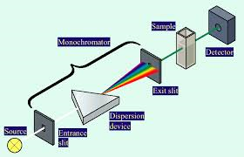
PARTS OF UV VISIBLE SPECTROPHOTOMETRY
Light Source
Produces ultraviolet radiation in the range of 200–400 nm.
Monochromator
Separates light into individual wavelengths.
Quartz Cuvette
Holds the sample solution and allows UV light transmission.
Detector
Converts transmitted light into electrical signals.
Display System
Displays absorbance values and spectra.
Parts of UV-Spectrophotometer
Slide no - 8

Slide 11
APPLICATION OF UV SPECTROPHOTOMETER
Slide no - 9

Slide 12
APPLICATION OF UV SPECTROPHOTOMETER
Drug Analysis
Quality Control
Water Analysis
Cosmetics Analysis
Agricultural Analysis
Chemical Analysis
Forensic Analysis
Slide no - 10

Slide 13
DRUG PROFILE OF CAFFEINE
Slide no - 11

Slide 14
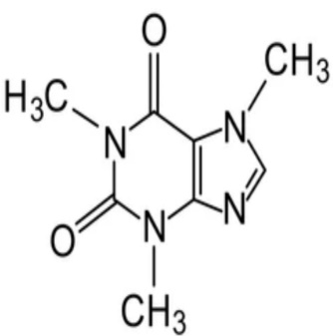
DRUG PROFILE OF CAFFEINE
Table no 1 – Drug Profile of Caffeine
Parameter | Description
Drug Name | Caffeine
Structure Formula
Chemical Formula | C₈H₁₀N₄O₂
Molecular Weight | 194.19g/mol
Category | Central Nervous System Stimulant
Drug Class | Methylxanthine
Appearance | White Crystalline
Solubility | Slightly Soluble In Water
Nature | Naturally Occurring Alkaloid
Uses | Improves Alertness & Reduces Fatigue
Sources | Tea , Coffee , Soft Drinks , Energy Drinks
Melting Point | 235–238°C
Slide no - 12

Slide 15
MATERIALS & INSTRUMENTS
Slide no - 13

Slide 16
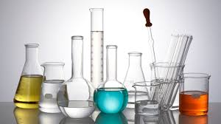
MATERIALS & INSTRUMENT
Chemical & Reagents Used
All chemicals and reagents used in the present study were of analytical grade to ensure accuracy and reliability of results.
Caffeine standard (pure drug)
Distilled water
Commercial energy drinks
All solutions were freshly prepared to avoid degradation and ensure precision.
Instruments Used
UV-Visible Spectrophotometer
Quartz cuvettes & Volumetric flasks
Analytical balance
Pipettes and Micropipettes
Beakers and Measuring cylinder
Sonicator
All instruments were calibrated prior to use.
Glasswares
Slide no - 14

Slide 17
EXPERIMENTAL METHODOLOGY
Slide no -15

Slide 18
EXPERIMENTAL METHODOLOGY
Step 1 : Standard caffeine solution preparation
Step 2 : Determination of λmax
Step 3 : Calibration curve preparation
Step 4 : Preparation & Dilution of beverage samples
Step 5 : Absorbance measurement and caffeine estimation
Slide no - 16

Slide 19
DETERMINATION OF WAVELENGTH (λmax)
Slide no - 17

Slide 20
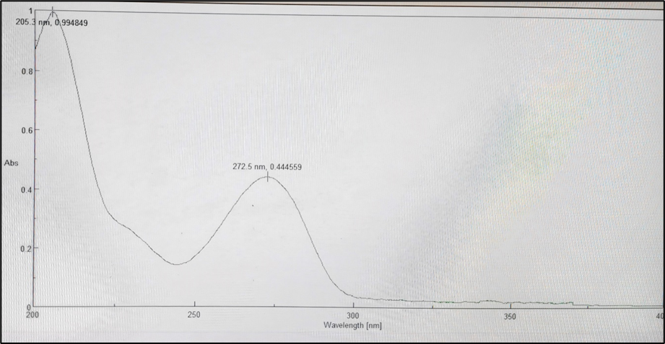
Determination of Wavelenghth (λmax)
A standard caffeine solution (10 µg/ml) was prepared.
The solution was scanned in the UV spectrophotometer over a wavelength range of 200–400 nm.
The wavelength at which maximum absorbance was observed was noted as λmax.
The λmax for caffeine was found to be approximately 272 nm.
Determination of λmax
The maximum absorbance (λmax) of caffeine was found at 272nm which was used for further Quantitative analysis.
Slide no - 18

Slide 21
CALIBRATION CURVE OF CAFFEINE
Slide no - 19

Slide 22
CALIBRATION CURVE
Preparation of Standard Caffeine Solution
Accurately weighed 10 mg of caffeine was dissolved in 10 mL of distilled water to obtain a primary stock solution of concentration:
Concentration = 1000 ug/ml
From this solution, 1 mL was further diluted to 10 mL with distilled water to prepare a secondary stock solution of concentration:
Concentration = 100 ug/ml
Preparation of Working Standard Solutions
From the secondary stock solution (100 µg/mL), aliquots of 1, 2, 3, 4, 5, and 6 mL were pipetted into separate 10 mL volumetric flasks and diluted up to the mark with distilled water to obtain working standard solutions of:10 20 30 40 50 60µg/mL
Slide no - 20

Slide 23
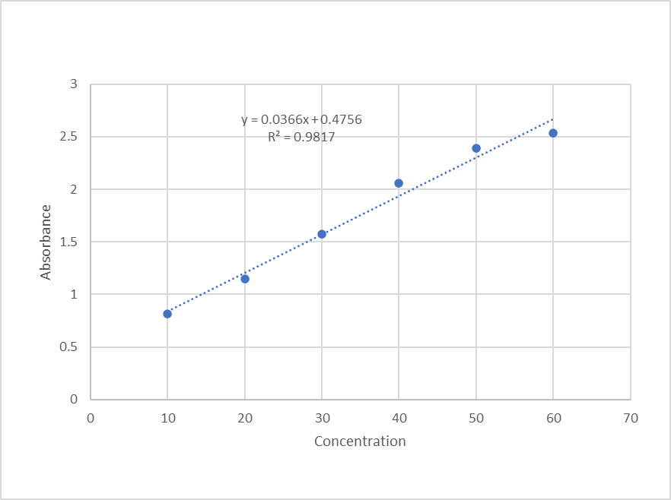
CALIBRATION CURVE
Concentration (µg/mL) | Absorbance
10 | 0.8191
20 | 1.1504
30 | 1.5771
40 | 2.0600
50 | 2.3928
60 | 2.5384
Table no 2 – Calibration Curve Data
Calibration Curve Of Caffeine
Y = Absorbance
x = Concentration
0.0366 = Slope(m)
0.4756 = Intercept(c)
Regression Equation
Y=0.0366x + 0.4756
Slide no - 21

Slide 24
CONFIRMATORY TEST :TLC METHOD
Slide no - 22

Slide 25
CONFIRMATORY TEST – TLC METHOD
Principle
Thin Layer Chromatography (TLC) was used for identification of caffeine based on Its Rf value.
Materials
Stationary Phase -Silica gel
Mobile phase: Chloroform : Methanol (9:1)
Sample: Standard caffeine (1mg/ml)
Dissolve pure caffeine in chloroform
Visualizing Reagent : Dragendroff Reagent
Formula
The Rf value is calculated using the formula:
Rf = Distance travelled by the Solute from reference line (cm)/Distance travelled by the solvent front from reference line (cm)
​
Slide no - 23

Slide 26
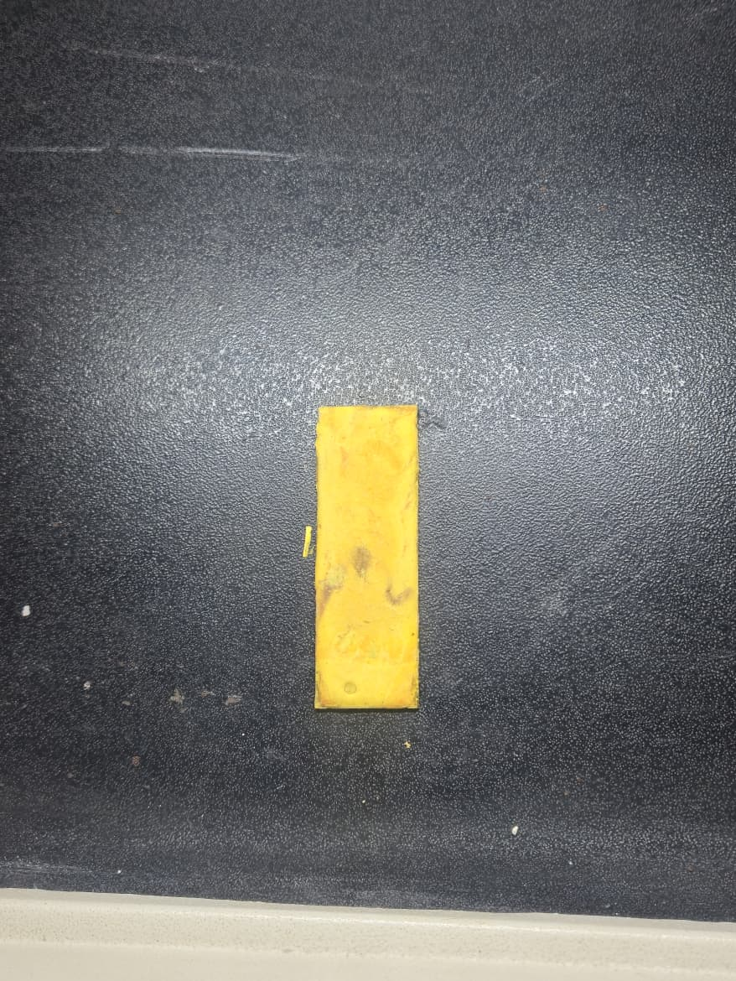
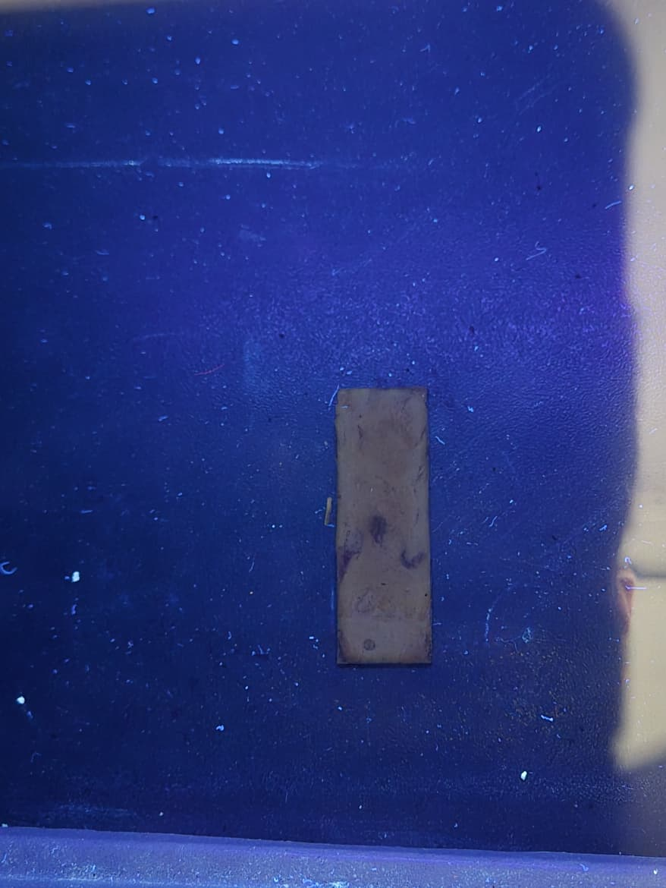
Calculation of Rf Value
Rf value is calculated using the formula:
Rf = Distance Travelled by Solute / Distance Travelled by Solvent
= 4 / 5.7
Rf = 0.70
Observation
Solute distance = 4 cm
Solvent front distance = 5.7 cm
Result
Rf value of caffeine was found to be 0.70, confirming the presence of caffeine in the sample.
TLC Plate
Slide no - 24

Slide 27
CALCULATIONS OF SAMPLES
Slide no - 25

Slide 28
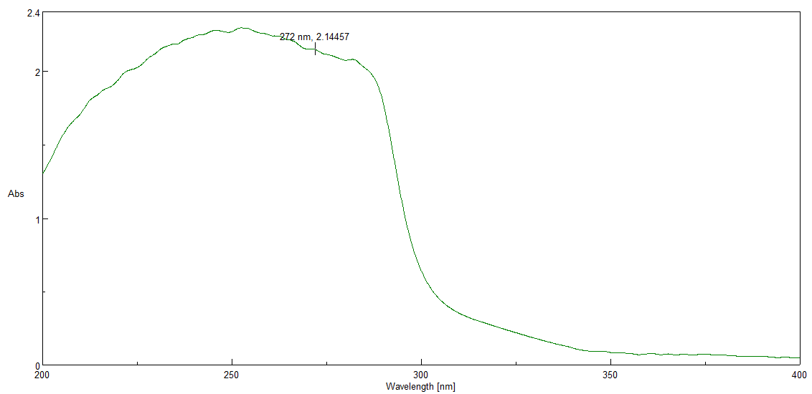
Sample 1 – Monster Energy Drink (90mg/350ml)
Monster Energy Drink Spectra
Slide no - 26

Slide 29
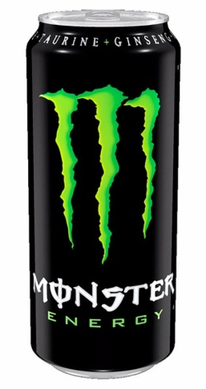
Sample 1 – Monster Energy Drink (90mg/350ml)
Step 1: Substitution of Values
Absorbance of Monster Energy Drink = 2.1
X = 2.1 -0.4756/0.0366
= 1.6244/0.0366
= 44.38μg/mL
Step 2: Applying Dilution Factor
Dilution factor = 5.99
Actual concentration = 44.38 x5.99
= 265.84μg/mL
Step 3: Calculation for 350 mL Beverage
Total caffeine = 265.84 x 350
= 93,044μg
= 93.04mg/350 mL
Monster Energy Drink
Slide no - 27

Slide 30
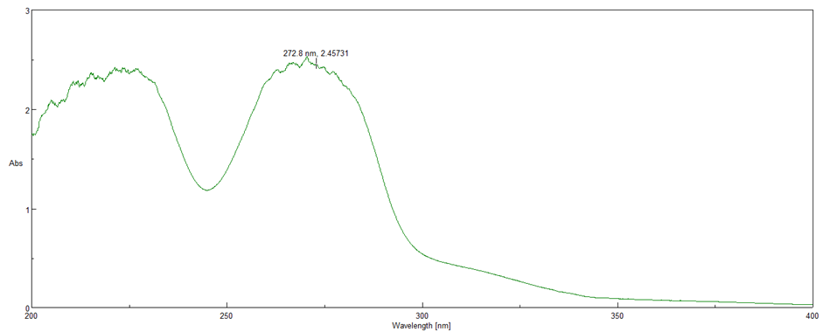
Sample 2 – Hell Energy Drink (75mg/250ml)
Hell Energy Drink Spectra
Slide no - 28

Slide 31

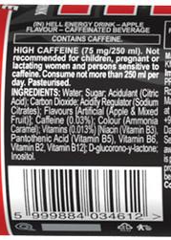
Sample 2 – Hell Energy Drink (75mg/250ml)
Step 1: Substitution of Values
Absorbance of Hell energy drink = 2.4
X = 2.4 – 0.4756/0.0366
= 1.9244 / 0.0366
= 52.58 ug / ml
Step 2: Applying Dilution Factor
Dilution factor = 6
Actual concentration = 52.58 × 6
= 315.48 ug / ml
Step 3: Calculation for 250 mL Beverage
Total caffeine = 315.48 x 250
= 78,870μg
= 78.87 mg /250 ml
The caffeine content in 250 mL of Hell Energy Drink was found to be: 78.87 mg
Hell Energy Drink and Label
Slide no - 29

Slide 32
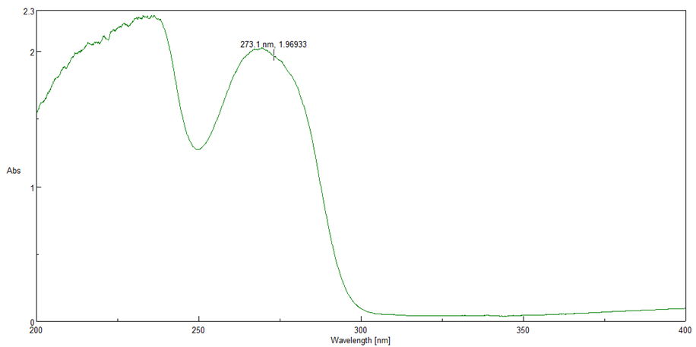
Sample 3 – Mountain Dew (52mg/250ml)
Mountain Dew Absorbance Spectra
Slide no - 30

Slide 33
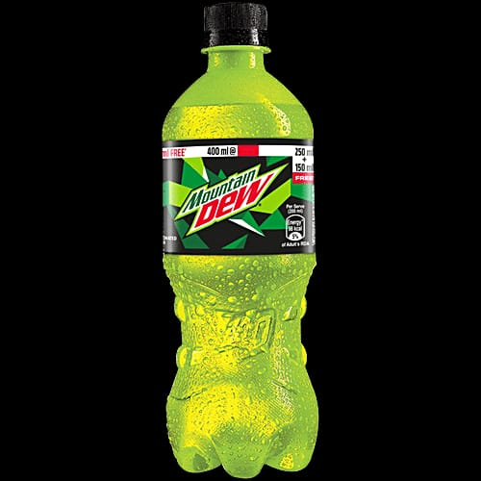
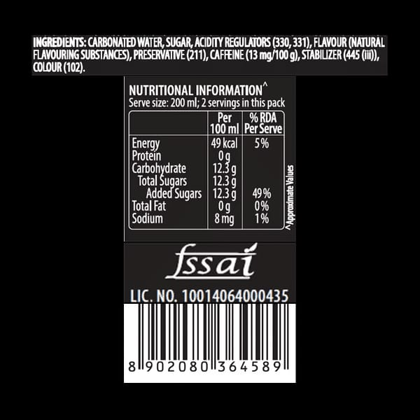
Sample 3 – Mountain Dew (52mg/400ml)
Step 1: Substitution of Values
Absorbance of Mountain Dew = 1.9
X = 1.9 – 0.4756 / 0.0366
= 1.4244 / 0.0366
= 38.93 ug / ml
Step 2: Applying Dilution Factor
Dilution factor = 3.25
Actual concentration = 38.93 × 3.25
= 126.52 ug/ml
Step 3: Calculation for 400 mL Beverage
Total caffeine = 126.52 × 400
= 50608 μg/400ml
= 50.61 ug/400ml
The caffeine content in 400 mL of Mountain Dew was found to be: 50.61 mg
Mountain Dew and Label
Slide no - 31

Slide 34
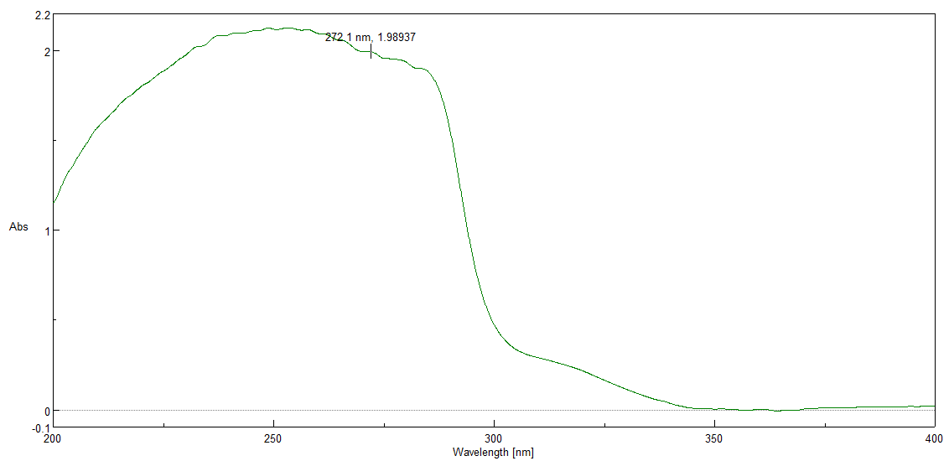
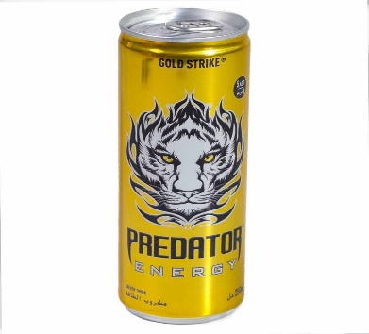
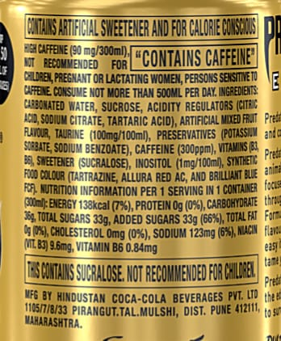
Sample 4 – Predator Energy Drink(90mg/300ml)
Predator Energy Drink Absorbance Spectra
Absorbance: 1.9
Dilution factor: 6
Caffeine content: 70.07 mg / 300 mL
Result:
The caffeine content in 300 mL of Predator energy drink was found to be 70.07 mg.
Predator Energy Drink & Label
Slide no - 32

Slide 35
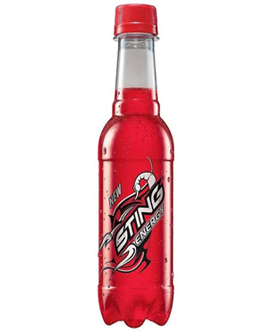
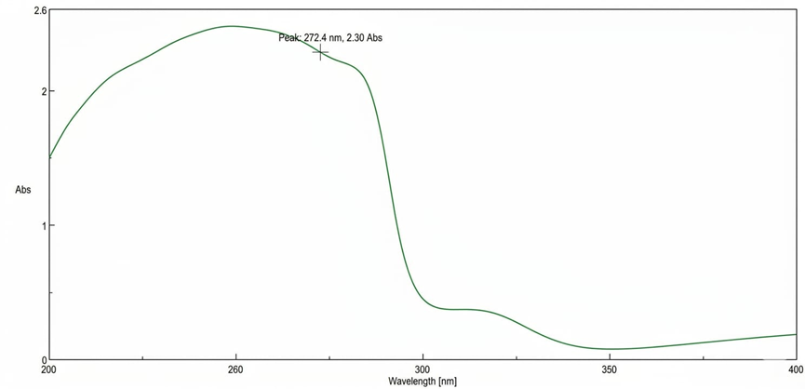

Sample 5 – Sting (72mg/250ml)
Sting Absorbance Spectra
Absorbance: 2.30
Dilution factor: 5.75
Caffeine content: 71.66 mg / 250 mL
Result:
The caffeine content in 250 mL of Sting energy drink was found to be 71.66 mg
Sting Energy Drink and Label
Slide no - 33

Slide 36
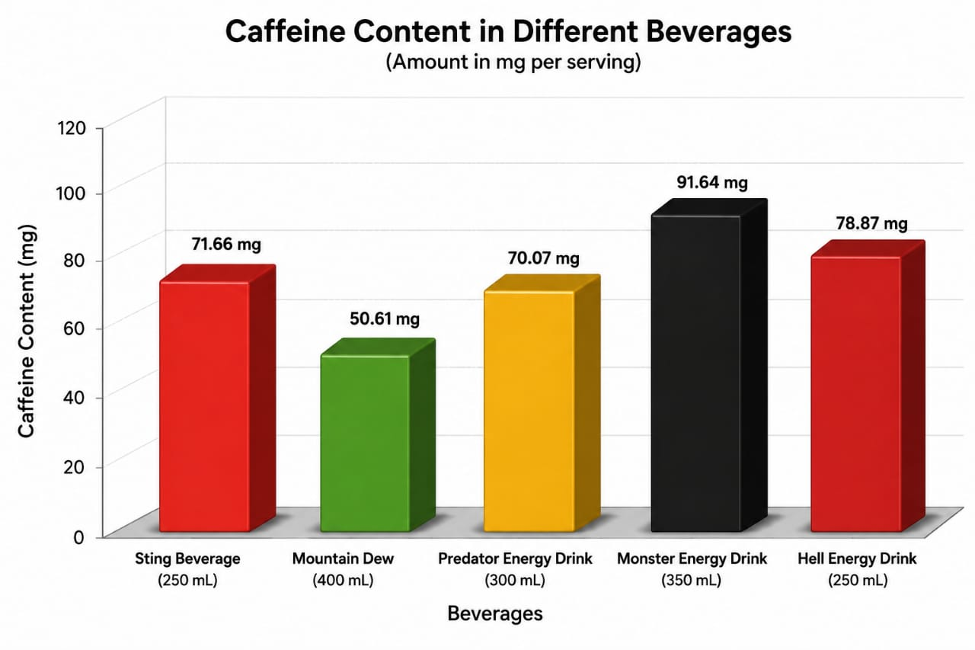
Caffeine Content In Different Beverages
Slide no - 34

Slide 37
RESULTS & DISCUSSION
Slide no - 35

Slide 38
RESULT AND DISCUSSION
Table no 3 – Caffeine Content Comparison Table
Sr. no. | Beverage Name | Volume (mL) | Absorbance | Dilution Factor | Caffeine Content (mg) | Label Claim (mg)
1 | Sting Drink | 250 | 2.30 | 5.75 | 71.66 | 72
2 | Mountain Dew | 400 | 1.9 | 3.25 | 50.61 | 52
3 | Predator Drink | 400 | 1.9 | 6 | 70.07 | 90
4 | Monster Drink | 350 | 2.1 | 5.9 | 93 | 90
5 | Hell Energy Drink | 250 | 2.4 | 6 | 78.87 | 75
Monster Drink showed highest caffeine content.
Mountain Dew showed lowest caffeine content.
Experimental values were close to label claims.
Observation
Slide no - 36

Slide 39
CONCLUSION OF PROJECT
Slide no - 37

Slide 40
CONCLUSION OF PROJECT
The present project entitled “Quantitative Estimation and Comparative Study of Caffeine Content in Selected Beverages Using UV Spectrophotometry” was successfully carried out with the objective of estimating and comparing the caffeine content present in different commercially available beverages.
In this study, different beverage samples were collected and analysed using standard UV spectrophotometric procedures. The calibration curve of caffeine was prepared by using standard caffeine solutions, and the absorbance values were measured at the selected wavelength. The obtained calibration curve showed good linearity, indicating that Beer‑Lambert’s law was followed within the selected concentration range. The caffeine content present in various beverages was then determined using the developed analytical method.
Slide no - 38

Slide 41
FUTURE SCOPE
This project will help in future for routine quality control and estimation of caffeine in beverages and pharmaceutical products using a simple, rapid, and economical UV spectrophotometric method.
It can be useful for pharmaceutical industries and food industries to monitor caffeine content and compare it with standard label claims.
The study may help researchers and health authorities to evaluate the health risks associated with excessive caffeine consumption such as insomnia, anxiety, hypertension, and increased heart rate.
The project can also create public awareness regarding safe caffeine intake and consumer safety.
Slide no - 39

Slide 42
REFERENCES & ACKNOWLEGEMENT
Slide no - 40

Slide 43
REFERENCES
Chatwal GR, Anand SK. Spectroscopy (Atomic and Molecular). Arora M, Anand A, editors. Mumbai: Himalaya Publishing House; 2009. p. 2.169.
Pavia DL, Lampman GM, Kriz GS, Vyvyan JR. Introduction to Spectroscopy. 5th ed. Stamford (CT): Cengage Learning; 2015. p. 369.
Sharma YR. Elementary Organic Spectroscopy: Principles and Chemical Applications. Multicolour ed. New Delhi: S. Chand & Company; 2013. p. 12.
De Caro CA, Haller C. UV/Vis spectrophotometry: fundamentals and applications. Switzerland: Mettler Toledo; 2025
Mendham J, Denney RC, Barnes JD, Thomas MJK. Vogel's textbook of quantitative chemical analysis. 6th ed. Harlow: Pearson Education; 2000
Ghosh S, Nandi S. A comprehensive review on UV-visible spectroscopy and its application. Int J All Res Educ Sci Methods. 2024 Jan;12(1)
Slide no - 41

Slide 44
A SINCERE NOTE OF GRATITUDE
THANKYOU
“With sincere thanks to our mentor Dr. Shraddha Tathe, the Department of Pharmaceutical Chemistry, and Sinhgad Institute of Pharmacy, Pune for the invaluable guidance, facilities, and support that made this research possible."
SUBMITTED BY
Sumit Kamble | Sushrut Randive | Sayali Renge | Samarth Sangle | Yuvraj Jagtap
SINHAGAD INSTITUTE OF PHARMACY , NARHE , PUNE | SAVITRIBAI PHULE PUNE UNIVERSITY
( 2025 – 2026 )

